Slide 1
Mass Spec & NMR Analysis of Polyester and Polyether Polymers
Alex Dospinoiu
4/18/09

Slide 2
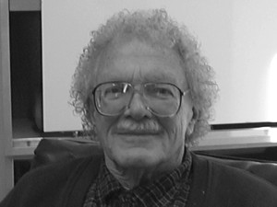
Interned with:
Dr. Henry Hall
University of Arizona
Department of Chemistry
Research focus:
Organic Monomer &
Polymer Chemistry
Special thanks
Dr. Robert Bates

Slide 3
Research:
Cannot disclose specifics
Research being conducted is done for a company
They provide multiple samples
Ask for in-depth structural analysis

Slide 4
So what can I present on:
If I cannot present specifics …
Lets go back to basics:
What is a polymer
What are polyester and polyether polymers
Mass Spectroscopy
Nuclear Magnetic Resonance (NMR)
Why the interest in these polymers

Slide 5
Polymer
from Greek πολύ-ς /po΄li-s/ much, many and μέρος /΄meros/ part)
Essentially
A large molecule
Repeating structural units
Classifications
Synthetic: Nylon, Teflon
Natural: proteins (wool, silk) DNA, RNA, polysaccharides (cotton)

Slide 6

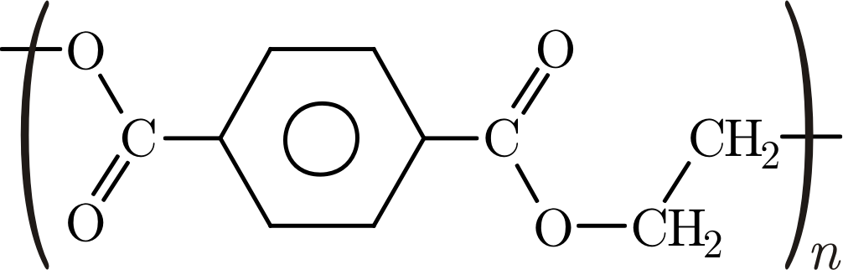
Polyesters
Used to make:
Bottles, films, canoes, LCDs,
Characteristics
Low water absorption
Low toxicity
Good mechanical properties
Example
PET (Polyethylene
terephthalate)

Slide 7

Polyethers
Used to:
Bring together a non-polar compound and water
Characteristics:
Very low chemical reactivity
Low toxicity
Much more polar than most organic polymers
Great water solubility
Example
PEG (Polyethylene glycol)

Slide 8
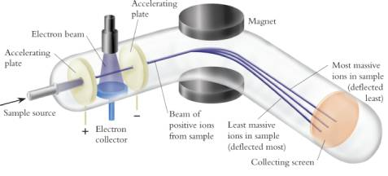
Mass Spectroscopy

Slide 9
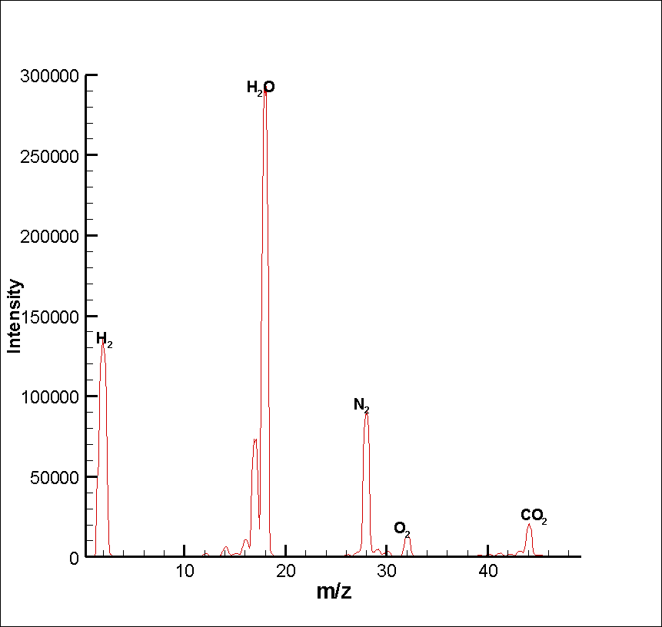
Results of Mass Spec
MWt
H -- 1
C -- 12
N -- 14
O -- 16

Slide 10


What we have observed:
We are looking at low molecular weight oligomers
We have found the molecular formula
“exact” MWt C_{x}H_{y}O_{z}
But we want the structural formula
Using Mass Spec/Mass Spec technique
MWt C_{x}H_{y}O_{z}

Slide 11
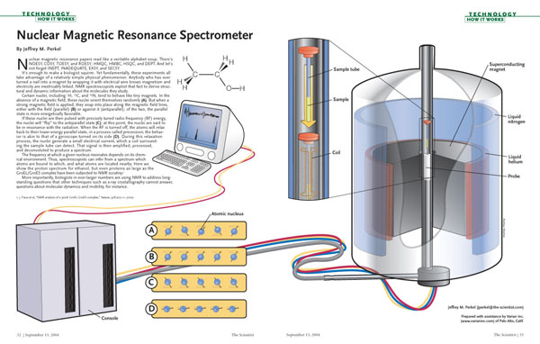
Nuclear Magnetic Resonance

Slide 12
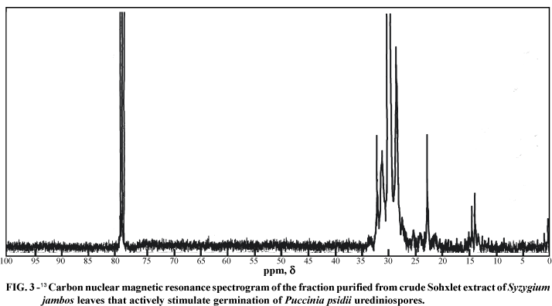
Results of NMR

Slide 13
What we have observed
NMR is not the best technique because we have a wide range of molecular weights
Has not been used much with these particular samples

Slide 14
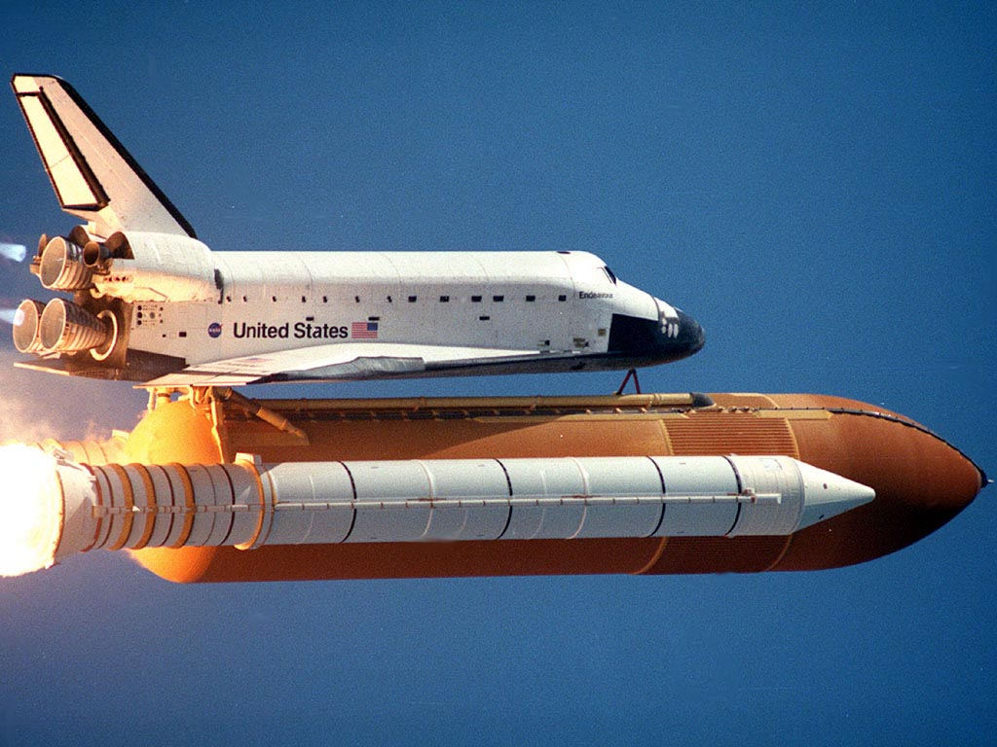
How does this apply to NASA?
These polymers are resistant to oxidation
Could potentially be used to store the liquid oxygen fuel
Decrease in weight
needed to be lifted
A lot of issues left to
be worked out

Slide 15

Questions?

